Slide 1
Combined Stakeholder Group
Q4 2018 Meeting
November, 2018 (9AM – 1PM)

Slide 2
AGENDA
Combined Stakeholder Group
9 – 9:05 | Welcome & Introductions | Kevin Cray
9:05 – 9:15 | Admin. & Action Items from Last Meeting | Neil Cowan
9:15 – 9:45 | Dashboards | Eric Van Orden
9:45 – 10:00 | Solar*Rewards Updates | Kristin Gaspar/Eric
10:00 – 10:05 | Introduction to COSEIA’s new CEO | Mike Kruger
10:05 – 10:15 | Break
10:15 – 10:30 | Solar*Rewards Community Updates | Shawn Queenan
10:30 – 11:00 | Walter Sharp Presentation | Walter Sharp
11:00 – 11:30 | Regulatory Update/Discussion NOPRs, EVs, & Other Filings | Jack Ihle/Neil
11:30 – 12:00 | Break/Lunch/Networking
12:00 – 12:45 | Stakeholder Group - Check-In & Look Forward With Special Guest Alice Jackson, PSCo President | Alice
12:45 – 1:00 | Wrap Up – Review Action Items, Future Agenda Items & Schedule Next Meeting | Kevin Cray

Slide 3
Admin. & Action Items from Last Meeting
Combined Stakeholder Group
Action Items:
  Transitioning from Windsource® to Renewable*Connect.
  Monthly RESA Reports on xcelenergy.com.
  Solar*Rewards Community – 2017 Awards and Updated Map
Admin. Issues:
  Stakeholder Group Website: Pre-2018 Materials
3

Slide 4
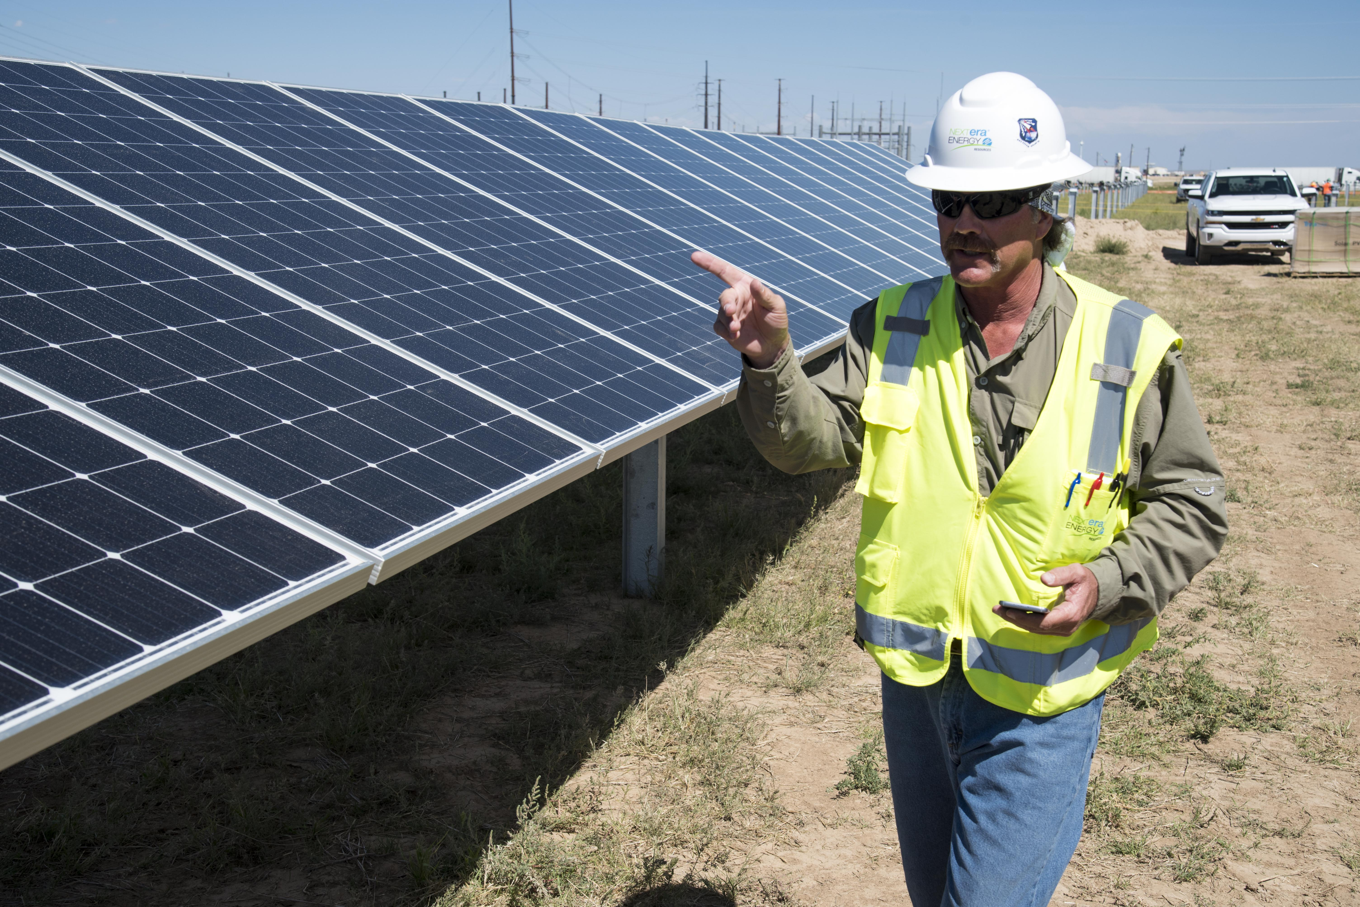
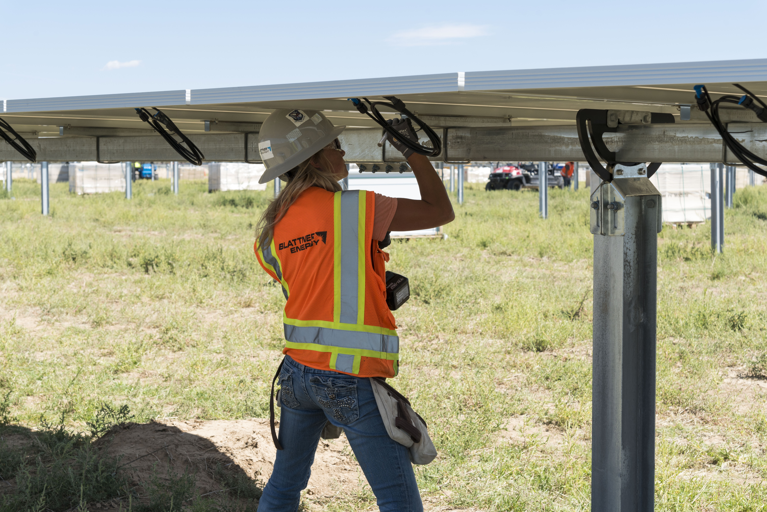
Renewable*Connect
Combined Stakeholder Group
Residential
  2,745 premises
  7,146 kW
Commercial
  572 premises
  3,088 kW
SG and PG
  153 premises
  39,766 kW
Construction nearly complete
Commercial operation by end of year
Notes:
More details on website

Slide 5
Solar*Rewards & Net Energy Metering Only - Dashboards
Combined Stakeholder Group
Private Solar Applications Received (Cumulative)
(kW)
*Of the 46.4 MW of NEM Large applications, 1.7 MW have progressed to the Engineering Review Stage or further in the development process. Of the 11 MW from NEM Medium, only 3.1 MW has progressed beyond Engineering Review.
Notes:
Keep in mind that we are giving you the raw data to stay current and dynamic. The cleaned up data with numbers are in the Monthly “Cumulative” Report.
We’ll see if the NEM Medium projects come to fruition. But, small are very likely.
We haven’t talked much about Large. But, those projects are gaining momentum. IBM for ~4 and 6 MW and two Amazon sites for 5.4 MW. 0.638 MW could roll into 2019.

Slide 6
Solar*Rewards & Net Energy Metering Only - Dashboards
Combined Stakeholder Group
Small Solar*Rewards & Net Metering Monthly Applications (YTD)
(kW)
Solar*Rewards Program provides up to 24 MW of annual REC incentives, which is available for up to 2 MW per month.
6

Slide 7
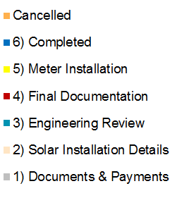
Solar*Rewards & Net Energy Metering Only - Dashboards
Small Solar*Rewards Stage
Small Net Metering Only Stage Status
(kW)
(kW)
*The cancellation quantity in February 2017 shows an excess of 675 kW that were cancelled almost immediately because of a delay in closing the program opening.
*Source data was extracted on October 1, 2018. There may be variances in future dashboards from similar periods, particularly the "Stage Status" graphs that are a snapshot in time.
7

Slide 8
Solar*Rewards & Net Energy Metering Only - Dashboards
Combined Stakeholder Group
Medium Solar*Rewards Stage Status
(kW)
Medium Solar*Rewards Quarterly Rollover Reason
Medium Solar*Rewards Quarterly Applications
(kW)
(Qty)
(kW)
(Qty)
628 kW was rolled over to December 2017 for a "Year end" application opening to account for No Deposits Received from earlier in the month of October.
*Source data was extracted on October 1, 2018. There may be variances in future dashboards from similar periods, particularly the "Stage Status" graphs that are a snapshot in time.
8

Slide 9
Solar*Rewards Update
Combined Stakeholder Group
2018 Solar*Rewards Program highlights
PUC granted a waiver to the City of Lafayette to allows their PV system to be relocated and continue to receive production incentives for the remaining term of the contract
Medium Solar*Rewards did not sell out for the first time during this RES plan cycle
2019 Solar*Rewards Program
Small Solar*Rewards (.05 kW – 25 kW)
  The Small Solar*Rewards program will continue to offer 2 MW of capacity per month with a $0.005 per kWh REC incentive
Medium Solar*Rewards (25.01 kW – 500 KW)
  The Medium Solar*Rewards program will continue to offer 6 MW of capacity per quarter with $0.0375 per kWh REC incentives
Large Solar*Rewards Program (500.01 kW – 14 MW)
  The Large Solar*Rewards program will be offered again in 2019 through a competitive bid process with a target capacity of 14 MW. Bidders will be evaluated on price per MWh and feasibility of project
9

Slide 10

Introduction to COSEIA’s new CEO
Combined Stakeholder Group
10

Slide 11
Solar*Rewards Community
Combined Stakeholder Group
2018 Review
- 18MW installed YTD, another 14MW expected by end of 2018
- 31.5MW started in applications in 2018, another 36MW to be awarded in December
- 49.5MW installed currently
- 88.3MW in development
2019 Preview
- 70MW on track to be installed in 2019
- 44MW of capacity to be offered through 2019 RFPs
- Possible formation of SRC subgroup
- discuss capacity maps
- lack of interest in standard offer
- 2019 RFP timing release
- additional topics
11

Slide 12
Solar*Rewards Community – Awards & Operations
Combined Stakeholder Group
PROJECT STATUS
•Interconnected 41 projects for 49.5 MW
•58 projects for 87.44MW accepted into the program
•Up to 15 projects for up to 1.5 MW open from Standard Offers
SOLAR GARDENS IN DESIGN & CONTRUCTION
Anticipated Installations (MW)
Status as of October 19, 2018 | Project sites | MW
Pre-engineering review | 15 | 22.34
Engineering Review | 5 | 8.1
Interconnection Study | 3 | 5
Construction | 35 | 52
Subtotal
Operational | 41 | 49.5
Totals | 99 | 137
MW
PROGRAM UPDATE
These numbers include the 2017 RFP awards
Regular and Low Income 2018 RFPs are due on October 19, 2018. The targeted award date is December 3, 2018.
Active projects group from 18MW to 49.5MW of capacity from Q1 to Q3 2018.
ACTIVE GARDENS
Subscriber Breakdowns
12

Slide 13
Solar*Rewards Community – Awards & Operations
Combined Stakeholder Group
Completed projects will double from Q4 2018 to Q4 2019
13

Slide 14
Regulatory Update / Discussion
Combined Stakeholder Group
Look back to 2018:
  CEP
  2 of 3 years of Three-Case Settlement
  R*C Launched
  HB-1270
  SB-09
  M-Docket, MOAR, Mega-NOPR, Workshops, Comments, Reply Comments, Final Comments…….
So what is next…?
  We are interested to hear what you are thinking?
14

Slide 15
Regulatory Update / Discussion (Cont…)
Combined Stakeholder Group
2018 |  | 2019 |  |  |  |  |  |  |  |  |  |  |  | 2020
N | D | J | F | M | A | M | Jun | Jul | A | S | O | N | D | J | F | M | A | M | Jun | Jul | A | S | O | N | D
SHG |  |  | SHG |  |  | SHG |  |  | SHG |  |  | SHG |  |  | SHG? |  |  | SHG? |  |  | SHG? |  |  | SHG?
NOPR (HB-1270) |  |  |  |  |  |  | RES Rpt.
 |  | Legislative Session
 | NOPR (M-Docket)
 |  |  |  |  |  |  |  |  |  |  |  |  |  |  | RES Plan
 |  |  |  |  |  |  |  |  |  |  |  |  |  |  | ERP - Phase I
 |  |  |  | ? 2020 RES Plan
 |  | ? DSP

Slide 16
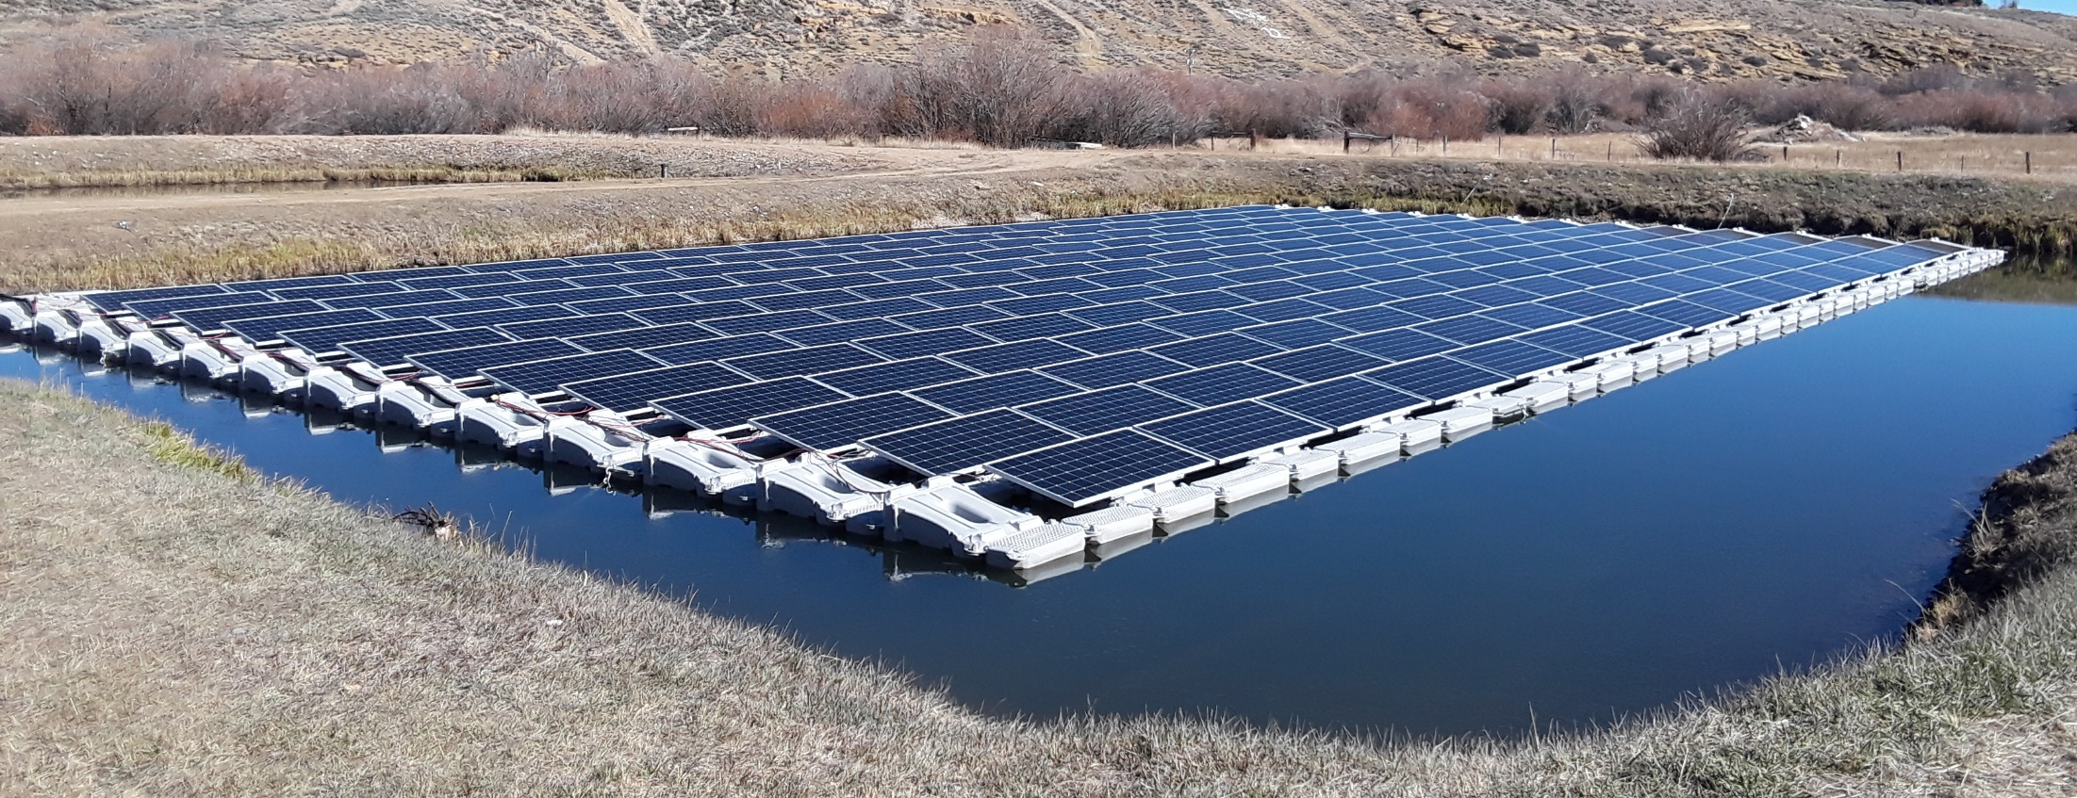
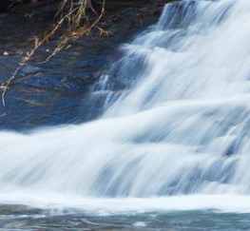

  Solar Floating Photovoltaic (FPV) Opportunities
  Xcel Energy Combined Stakeholder Group
  November 16, 2018
Walter M. Sharp, 720.232.1089
Solar Floating Photovoltaic Expert
Chief Collaboration Architect

Slide 17

Single Resource, Multiple Environmental Benefits
Water
  Significant impact on managing drought-related conditions and other water management interests, including reducing evaporation, inhibiting cyanobacterial blooms, and reducing the turbidity from bank erosion.
Solar Power Generation
  Uses renewable energy fuel source to provide locally-sourced and delivered electricity – can be used to offset electric demand on-site, or transferred to the utility or other local users.
Location, Location, Location
  Freshwater irrigation, drinking water (raw or potable), water reuse, hydroelectric, pumped hydroelectric storage, reservoirs, lakes, ponds, late-stage wastewater lagoons, storm water detention, aquifer recharge basins, etc. are examples of the types of locations and respective operating organizations that can benefit from FPV.
Walter M. Sharp
720.232.1089
Copyright ® 2018

Slide 18
Compatibility & Specifications
Water Conservation and Quality
    30-50+% reduction in evaporation rates on covered surfaces;
    Denver Front Range open water evaporation rate 2-4’/yr.
    Seasonal water temperature stability reduces algae growth and potential cyanotoxin production.
Water Surface
  2 ½ acres (A) per megawatt (MW) AC or DC nameplate rating.
Water Level Change
  Seasonal 20 feet to 100 feet daily for pumped hydroelectric reservoirs.
  Compatible with intermittently dry locations such as groundwater recharge basins and irrigation ponds.
  Maximum wave height 1m (~3’) and velocity 1m/s (~3’/s).
Walter M. Sharp
720.232.1089
Copyright ® 2018

Slide 19
Compatibility & Specifications (cont’d)
Electric Generation
  Increased production efficiency of 10+% for silicon-based PV cells, due to the cooling effects of the water verses comparable ground-, carport- or roof-mounted PV systems.
Electric Energy Storage
  Compatible with Pumped Hydroelectric and Battery. Can improve system economics in regions where electric utilities have Time-of-Use rate structures and charge more during peak demand.
Electric Delivery
  On-site loads – Net Metering.
  Off-site loads – Aggregate Net Metering, Shared/Community Solar, Electric Utility Direct, etc.
Walter M. Sharp
720.232.1089
Copyright ® 2018

Slide 20
Compatibility & Specifications (cont’d)
Electric Delivery (cont’d)
  Off-site loads (cont’d)
    Aggregate Net Metering; same owner, same rate class
    Delivery location; Same or adjacent parcels
    Community Solar Garden; up to 2MW per legal parcel, single subscriber limited to 40%, of up to five gardens
    Delivery location; Same or adjacent county
    Utility direct; may require accepted bid response through a ERP/IRP (Electric Resource Plan/Integrated Resource Plan) process that occurs once every 4-5 years
    Delivery location; Everywhere within Electric Utility operating territory
      ERP/IRP process is not optimized to evaluate the full value of distribution feeder connected renewable energy generation
Walter M. Sharp
720.232.1089
Copyright ® 2018

Slide 21

Case Study, Walden CO
https://www.dropbox.com/sh/1iv961kol3n3bmd/AADXKQ0Dy8BKIUB0o_oETfC0a/Orlando%20Floating%20Solar%20Array.mp4?dl=0
Walter M. Sharp
720.232.1089
Copyright ® 2018

Slide 22
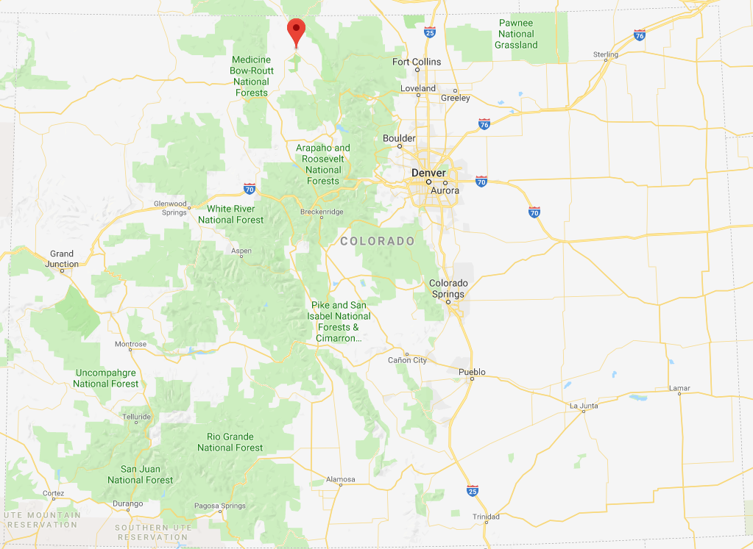
Town of Walden CO
The Town of Walden CO (Walden), sits at an elevation of 8,099’ above mean sea level in Jackson County, the North Park region of Colorado. Walden is the Jackson County Seat, the only incorporated town in the county, and home to the Jackson County School District
Image; Google Maps
Walter M. Sharp
720.232.1089
Copyright ® 2018

Slide 23
Town of Walden (cont’d)
Led by Mayor Jim Dustin and the Town Board of Trustees, the Town has the Desire and willingness to generate local electric power to energize the Towns’ operations
  Town Hall, drinking water and wastewater treatment plants, street and baseball park lighting, and natural gas distribution facilities using renewable resources
Upon learning about FPV as an option, the drinking water treatment plant (WTP) was selected to receive the Town’s first solar electric power generation facility
The FPV installation will generate enough electricity to serve 100% of the on-site electric load on an annualized basis utilizing net-metering
The reduced evaporation has increased the water supply for Walden residents and raised awareness on water conservation, and with the electric cost savings, the Town is able to have funds to better serve its’ citizens.
Walter M. Sharp
720.232.1089
Copyright ® 2018

Slide 24
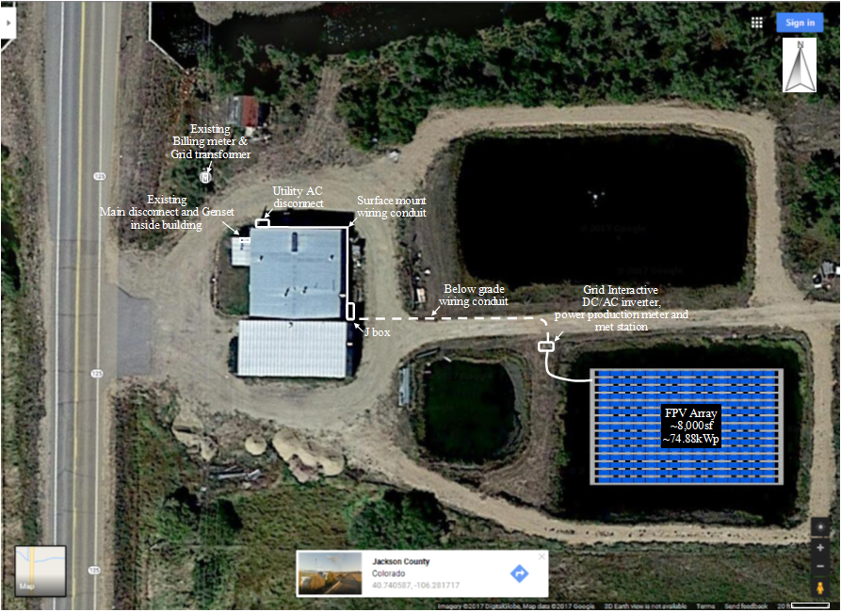
Town of Walden CO WTP, site layout
Walter M. Sharp
720.232.1089
Copyright ® 2018

Slide 25
WTP FPV Specifications
Requirements; Generate on-site, 100% of the electric power usage, using renewable resources, continuously monitor system performance
PV Modules; 208 ea. 360WpDC, 74.88kWpDC
Grid interactive inverter; 60kWAC/66kVA
Tilt and orientation; Fixed tilt 12°, azimuth 180° (due south)
First year estimated power production; 101-109MWh (~12.8kWh/sf 1st yr.)
Array dimensions; 111’ x 74’ (8,214 sf), equivalent ground mount system at 30° fixed tilt would occupy ~15,000 sf (Osprey)
Anchoring and mooring; nine shoreline earth anchors, equivalent ground mount system would require up to 312 earth anchor points (Osprey)
Estimated installation time; 228 hours verses Osprey ground mount ~2+x
Service life; >25 years
Walter M. Sharp
720.232.1089
Copyright ® 2018

Slide 26
Town of Walden Next Steps
Measure key metrics around cost savings, water supply, and water quality.
Install Shared/Community Solar Garden/Micro Grid to serve the electric needs of the remaining Town of Walden facilities, Jackson County offices, Jackson County School District facilities, local residences and businesses, and future electric vehicle (EV) charging stations.
Walter M. Sharp
720.232.1089
Copyright ® 2018

Slide 27
Road to 100%, Innovative solutions
Enhanced Electric Market Opportunities
  Remote (net) Meter Aggregation (RMA)
    Net meter for non-adjacent parcel loads, entities and organizations can aggregate their individual on- and off-site loads sharing a common dedicated or shared on- or off-site FPV electric generation facility (or facilities).
Walter M. Sharp
720.232.1089
Copyright ® 2018

Slide 28
Opportunities for Community engagement
Communities, cities, towns, counties, state, federal, utilities, enterprise districts, academics, scientists, and other interested stakeholders coming together to Collaborate on water and locally sourced renewable energy generated electricity related matters throughout CO to Assist communities in reaching their climate and electric generation goals
Conducting an inventory of CO solar FPV potential. Completing installations of FPV throughout CO. And Quantifying the effects (benefits) of FPV on water quality (algae growth and cyanotoxin production, dissolved oxygen levels, PH, water temperature stratification, etc.), source water conservation (evaporation rates), other water related environmental factors (shoreline erosion, aquatic life, etc.), and electric power generation efficiency
Learn ways to continue improving the FPV offering so more organizations can enjoy the benefits of floating solar power.
Walter M. Sharp
720.232.1089
Copyright ® 2018

Slide 29
Parting remarks
"With demand for solar power continuing to rise and available real estate becoming more expensive, floating solar is the ideal solution for anyone with a manmade pond or body of water. It's cost-effective, quick to install, easy to maintain, and offers a variety of environmental benefits. Floating solar is no longer an exotic niche in the US, but a rapidly growing sector of the solar market.",
Eva Pauly-Bowles, Representative Director for Ciel & Terre USA, Inc.
Walter M. Sharp
720.232.1089
Copyright ® 2018

Slide 30
Stakeholder Group – Check-In & Look Forward
With Special Guest
Alice Jackson, President
Public Service Company of Colorado
Combined Stakeholder Group
30

Slide 31
Combined Stakeholder Group Wrap Up
Combined Stakeholder Group
Review Action Items
Future Agenda Items
2019 Meetings (Feb., May., Aug., Nov.)
31

Slide 32


